Slide 1
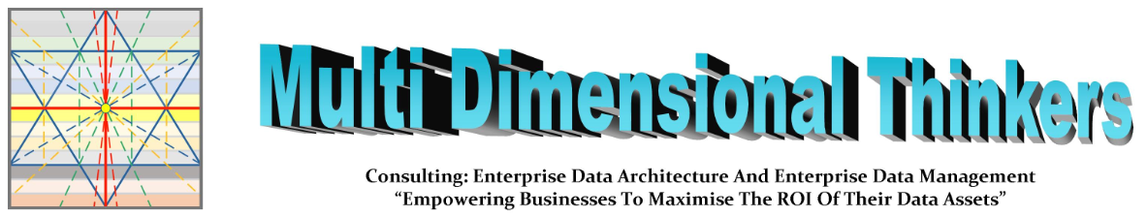
Exploring and Understanding
The Cage of Data
MDDMF Journey v1.0 – v7.0
(Share and enable speakers)
Free to All, cannot be copyrighted, as already in the Public Domain
Presented by: William Evans 2024-12-21

Slide 2
To truly succeed you need to think differently
This talk covers:
You need a fresh perspective
You need neural pathways to go where others cannot
Opportunity for those wanting to bring this out:
You need education in how it works, moves, flows, stalls, and decays
You need experience applying your knowledge
You need a feedback mechanism to check yourself

Slide 3
The CEO asks the CFO and CDO.
Which of you two is more important?

Slide 4
How the E-Team beat all the opposing A-Teams

Slide 5

How do you see all sides of the football at once?
OUTSIDE
You can only see a portion of the Sphere, and do not understand wholistic cause and effect
To control it, you have to break it up into segments and knit them together
Just like Business Capabilities
INSIDE
You can not see colour, nor what outside stakeholders see
You can see how each part of the football affects all the other parts
And what the effect is on each of the different areas
Everyone’s view is catered for: but they need to sit together to understand the whole.
For that they need something that has all views simultaneously
Enter the MDDMF.

Slide 6
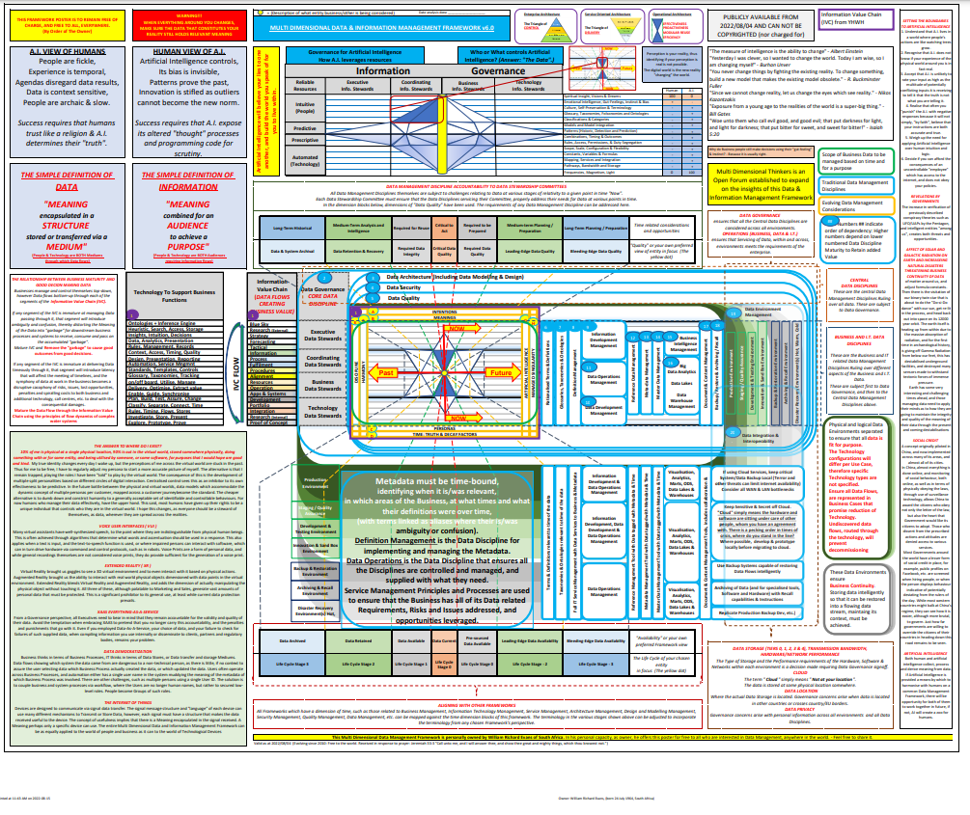
The MDDMF is a thinking tool for ensuring you have thought matters through.
Who should be using this:
  All Architects
  Business Advisers to Decision Makers
  Business Analysts
  Business Data Stewards
  Data Analysts
  Data Stewards
  Information Stewards
  Technical Stewards
  Your Take Away:
  https://multidimensionalthinkers.com/MDDMF-V7-0-New-Release/
Who should be Aware of this:
  Chief Data Officer
  Chief HR Officer
  Chief Information Officer
  Chief Security Officer
  Chief Technology Officer
  Senior Management Decision Makers

Slide 7
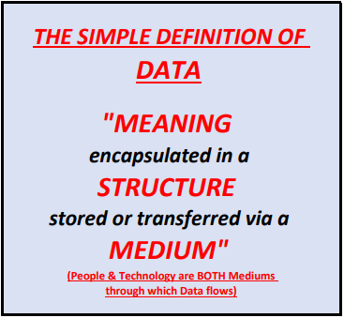
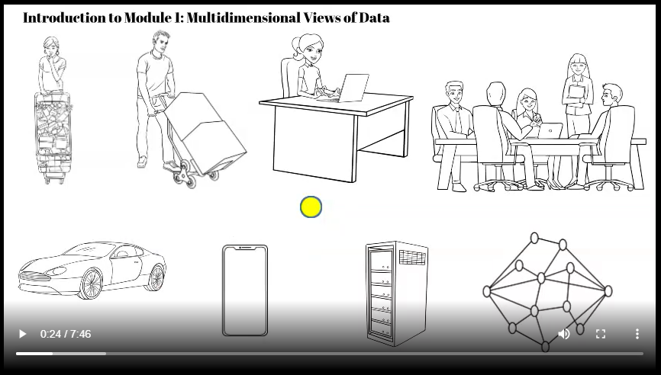
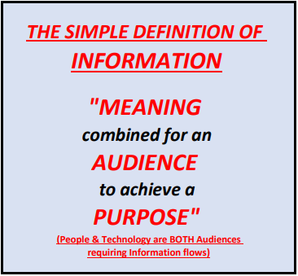
The MDDMF is a thinking tool for ensuring you have thought matters through.
0. Data Management
Warning Video contains Fast moving images (no bright lights)
Click to play Business Context and Introduction to Contextual Decision Making

Slide 8
Workshop Agenda
1. Simple Understanding of Data
2. The Information Value Chain in your Enterprise
3. Enterprise Architectures across Information Value Chain segments
4. Time, Control, Delivery, Cost & Effort Considerations
5. Identify KPAs for data stewardship
6. Identify KPIs which address the Information Value Chain segments
7. Version Developments over the years

Slide 9
1. A Simple Understanding of Data

Slide 10
The three main types of Data (each have their own Meta-data)
Reference Data
  and its own Meta-data
Master Data
  and its own Meta-data
Transactional Data
  and its own Meta-data
Meta-data is not aa different type of Data.
Meta-data is simply one of the three types of Data used to provide context and clarity to a specific piece of Data.

Slide 11
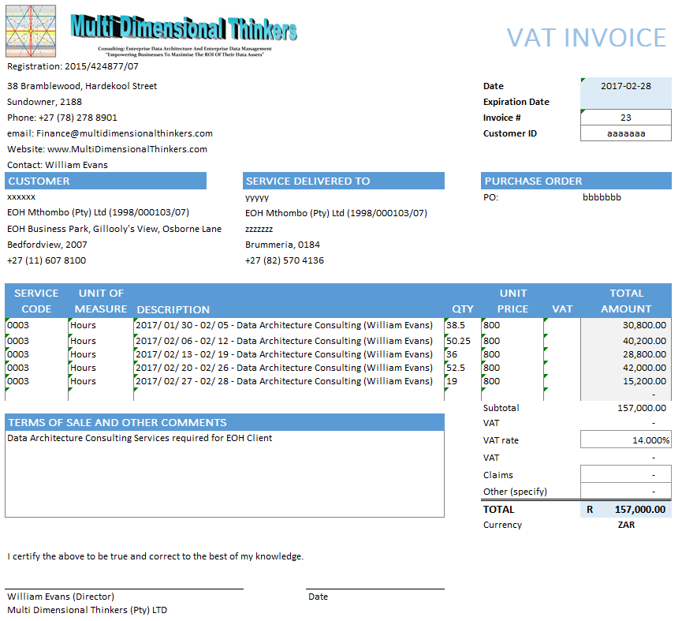
Visual of Data (An Invoice)
Meta-data

Slide 12
Visual of Data (An Invoice)
Reference Data

Slide 13
Visual of Data (An Invoice)
Master Data

Slide 14
Visual of Data (An Invoice)
Transactional Data

Slide 15
Visual of Data (An Invoice)
Meta-data
Reference Data
Master Data
Transactional Data

Slide 16
Analogy: When weaving a carpet, there are 3 different threads A thread is a data attribute. Each millimetre of thread is instantiated data of the attribute of that thread.
Here is a simple explanation of Data Functioning in an Enterprise
Simple Weaving Loom (An Invoice with 3 types of data)
  https://www.youtube.com/watch?v=aT6gx4db7z8
Automated Weaving Looms (One per Siloed Business/Business Unit)
  https://www.youtube.com/watch?v=ZYU5T9t7-oo
Circular Weaving Loom (An Enterprise’s 3 types of data)
  https://www.youtube.com/watch?v=zhzf6cIEGM8

Slide 17
2. The Information Value Chain in your Enterprise

Slide 18
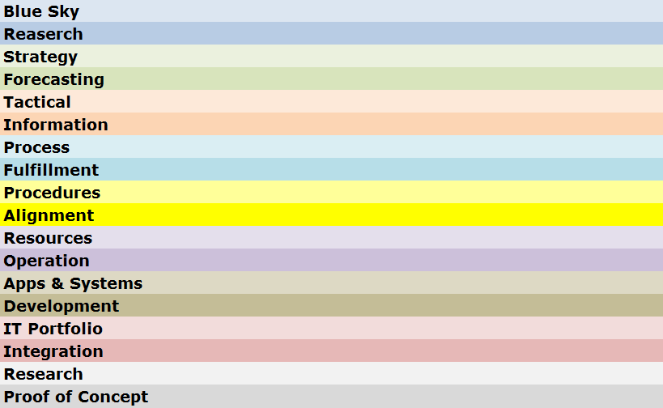

Understand the data flow through the Information Value Chain
Understand the data flow through the Information Value Chain
Information Value Chain
Silos created through lack of end-to-end process Map.
Business areas fulfil KPAs and KPIs in isolation of one another, destroying one another’s efficiency capabilities
Build end-to-end process Map “Brisbane Road Map Book” Concept.
All Business areas fulfil KPAs and KPIs synchronously with each other, strengthening one another’s efficiency capabilities
Business Direction
Data is an
Enterprise
Asset
And must
Flow
Business Run
0. Information Value Chain
Business Enabled
Notes:
The words should be seen as segments of a hosepipe where the segment below supplies the Business needs of the segment above. These can be broken into 3 segments: Business Direction, Business Run and Business Enablement.
Just as water flowing quickly through a muddy river, has brown cloudy water, and water flowing through glass pipes will be crystal clear, it is the environment that data travels through that determines its quality.
Each of these segments have a different set of forces causing poor data quality, and each needs to be understood, measured and managed. It is therefore unreasonable to blame the Applications and Systems Segment for poor data quality, when the Enterprise does not have a single map of their End-to-End Processes. Processes such as “Order-to-Cash” or “Hire-to_Retire”, each with empowered and financed Process Owners.
The “Information Value Chain” is a term we use for this flow through these segments, and while data is a continuous flow (counter-clockwise) it must be managed continuously based on the source of where that data is emanating from (clockwise)
Business Connexion was referred by KID as a flagship of a mature enterprise into which Master Data Management as a Business capability could be easily introduced. At the SAPHILA Conference of 2012, BCX was asked to present their success and noted the critical success factors for implementing a successful MDM solution. All of these rely on maturing the different segments of the Information Value Chain.

Slide 19
3. Enterprise Architectures across Information Value Chain segments

Slide 20
Enterprise Architecture Triangle
1
Business
Processes
Terms & Definitions
Resources
Notes:
The Circle in the centre of the model is any object you choose to be placed under scrutiny. If you want to make the object the “Customer”, or a “specific Product”, or maybe a “Role you are defining in your organisation. You can focus on a particular Business Capability, or you can make this a particular system or Application. In fact the model is so generic you could use it for your own car.
The Apex-Up Triangle refers to the Traditional Enterprise Architecture triangle, however, when aligned to the Information Value Chain, a more granular flow of data is observed to be running through the Enterprise.

Slide 21
Service Oriented Architecture
1
Business Processes
Data Objects
Services
Technology
Notes:
About three years ago I came across Shawn Simon (Oshyn Powering Innovation)’s graphical representation of Service Oriented Architecture, which he describes in his Article on “SOA Turning things Upside Down”. (http://oshyn.com/soa/soa-turning-things-upside-down )
Over the many years of running IT systems, new data sources and data flows are created, without decommissioning the old ones. Often this is because there is little or no records or understanding of who or what else may be using these data flows. While Businesses restructure regularly, applications and systems are expected to take on new roles and provide new capabilities. This simply keeps adding complexity to data flows, and inaccuracies over time as semantics and terminology and definitions change. Eventually the IT system(s) has become a tangled ball of wool that tightens the knots with every new Business Request. (Restructures causing loss of IP only makes matters more unrecoverable)
SOA was thought to be the solution, however, simply rebuilding services based on the current mess of antiquated and no longer used (but still supplied) Business Integration Requirements creates duplication of effort, a plethora of conflicting services and servicing rules, and maintains waste of storage, bandwidth, performance, etc...
The CDO must drive the rationalisation of Business Terms and Definitions, which serves to expose duplicated Business Processes, originally considered to be different, but when confusing and ambiguous terms are rationalised, there may be one process, with minor tweaks required to service everyone’s needs. This leads to singular, Enterprise-Wide Definition of Data Objects which are reduced in complexity and devoid of confusion and ambiguity. With rationalised Data objects comes a far simpler set of easily manageable services from a rationalised set of data sources to service the real Business needs. This in turn means data flows are lifted out of legacy technologies, and these can be taken to cheaper resources, and finally archived.

Slide 22
Enterprise Architecture
Understand data touch points between EA and Information Value Chain Segments
2. Data Architecture
How the Architectures work together
ENTERPRISE
DATA
ARCHITECTURE
Enterprise
Business Architecture
Business
Information
Reporting Architecture
Process
Process Architecture
0. Information Value Chain
Delivery
Architecture
Operations
Enterprise
Resources
Application
Information Technology Architecture
Infrastructure
Enterprise
Notes:
Speaking of Architectures (Remember that these are simply the maps that show where everything is, how it is connected, and what enables what to work. If there is no true accurate architecture, there will always be unintended negative consequences.
Enterprise Architecture focuses on ensuring value is derived from Innovation and Proof of Concepts, however, they also integrate all the other Architectures.
Business Architecture works very closely with Enterprise Architecture, and owns the Business Value Chain(s) and Business Capability Models.
Information Architecture (sometimes referred to as Reporting Architecture) shows how the needs of the Business for Information are met and from which sources.
Process Architecture focuses on the End-to-End Business Processes that support the Business value Chain, linking the Business Procedures to one another in a single integrated map of interactivity.
Operations Architecture is the actual Work Instructions and Procedures that make the Business Work (For humans in human language, and for systems in programming code and signal configuration). This is where data quality is usually assumed to be perfect, and usually data quality problems cause ever-widening circles of unintended consequences impacting business Value. Data Quality is a core function.
Resources Architectures focus on all resources, owned and non-owned, be they human resources, information, technology resources or raw or processed materials. For each of these resources, there are one or more roles, and for each role there is an expectation to receive semantically correct quality data, for them to fulfil their function and generate semantically correct quality output for the next resource in the procedure to use.
Application Architectures focuses on any tool used for a purpose. Typically we think of software IT Applications and Systems, which must be fit-for-purpose, and must receive good quality data, that meets the semantic definition expected by the creators of the Application/system, to deliver a correct result for resources to use.
Infrastructure Architectures focuses on the IT Hardware, configuration, routing, scaling and performance of data

Slide 23
Service Oriented Architecture
Understand data touch points between SOA and Information Value Chain Segments
2. Data Architecture
ENTERPRISE
DATA
ARCHITECTURE
Enterprise
1. Business Value Chain
Business
2. Business Capabilities
Information
3. Reporting Rationalised
Process
4. Procedures Rationalised
0. Information Value Chain
5. Tasks Rationalised
Operations
Resources
6. Data Rationalised
Application
7. Data Flows Rationalised
Infrastructure
8. Simplified Effective SOA
Enterprise
Notes:
The various Architectures need to interact with one another and properly unite and integrate their different catalogues and models to be able to perform a “data-protected” IT Application and systems restructure to remove the dead-wood legacy applications, while maintaining the Enterprise’s ability to deliver on its daily requirements.
Business Functions must properly define their Business Value Chains, selecting the Business Capabilities already defined by Business Architecture to ensure they can still deliver. (Unused Business Capabilities can be scrapped or sold off). Only reporting for required Business capabilities must be kept, and these must be modularised and data driven to support different functions. Only procedures which drive the Business Value Chains (HR is of itself a Value chain even if it does not generate an Income) must be kept and all reporting must be re-evaluated based on the new business requirements.
Often tasks are performed for no apparent reason. Sometimes it is because downstream somewhere, this information is critical and collection at this task is ideal, in which case keep it, and sometimes it was done because a long time ago someone needed it, but it is no longer required (beware of scrapping tasks used to support long-running cycles, e.g. annual reporting)
Reducing tasks, almost always reduces confusion and ambiguity as terms and definitions drop off the requirements list. This also simplifies the Data Object Models.
Map all the data flows and Identify obsolete data flows based on identifying which data no longer adds value to the value chains. Ensure that these data flows are not conduits for transferring data to different Business Processes elsewhere in the Business. If they do identify the data to be moved via a service before decommissioning the Data Flow.
Now it is possible to build SOA Services intelligently, and to a rationalised set of Business Process es requiring the data. Management of the reduced data flows also becomes less error-prone, creating less unintended errors and consequences, which simply create more fires to fight.

Slide 24
4. Time, Control, Delivery, Cost & Effort Considerations

Slide 25
Cost and Effort Architectures
2. Data Architecture
1
NOW
0. Information Value Chain
Past
Future
NOW
Notes:
So far we have discussed the Business, its Architectures and data as it flows and services the Enterprise’s needs. However, The Chief Data Officer’s accountability extends way beyond the data and its use within the business.
The CDO must consider and remain the steward over data that would be used by the business, as well as data already used by the Business, which introduces the dimensions of time indicated by the red lines crossing in the centre of the model.
This model now becomes a living moving model, as the yellow circle (that which you have chosen to be the object under your focus) must be seen to be continuously moving from left to right, with the focus circle being at the intersection and being the immediate moment of now. In fact along the entire Information Value Chain there will always be an identical moment in time referenced across each segment as being the moment “NOW” (or this instant in time).
The other 8 intersecting lines radiate outwards from the intersection and divide the subject under focus into time sections. The further we move in any direction away from the center, the greater the cost and effort of attaining and maintaining data in this dimension. Therefore it is essential to achieve a sustainable maturity before reaching for “low hanging fruit” in segments beyond current real appetite to consume. The expanding distance between the lines as you move from the centre indicate the tolerances for data quality (expensive) as a trade off against the purpose for which the data is being used (the Info Value Chain segment it is in)
The second important observation is that the intersection and in fact the object under focus rests on the line between “Alignment” and “Procedure”. “Alignment” means I have definition of everything I have at my disposal, and “Procedure” means I have one or more activities that I will be performing using what I have.
For the CDO, everything goes wrong when anyone can decide what definition to apply at any point in a procedure. The CDO must therefore own the Terms and Definitions across the Enterprise and enforcement of correct use is everyone’s responsibility.

Slide 26
Time Architecture
2. Data Architecture
1
NOW
Past
Future
0. Information Value Chain
NOW
Notes:
The concept of time has been discussed, however the Architecture of time must be understood. Time Architecture is entirely dependant on the object under focus. For example people refer to a dog as living 7 years for every one of their own. Time relativity is therefore dependant on the lifespan of the object under focus.
In terms of data, we know that certain data may not be destroyed until a certain number of years has passed since it was last used. So if we have “Customer” as our focus, we can set our furthest blue line to the left to a time span of 15 years (depends on your industry)
The 2 next segments moving to the right are then when to stop keeping the data (and resources) available at low performance or at high performance, and the segment closest to the “Now” line is data currently in use, and in the process of being continuously re-used (Data Quality permitting).
The furthest to the right line indicates when the first time you would want insight into the need for a new attribute for a customer object. This requires significant research effort in where the world is going, and where technology is going to understand the usefulness of such data. The CDO’s Visionaries would work in this space.
The 2 lines in between when it would be ideal to have data prepared and ready for use (Master Data Management falls into the second leading-edge segment, while the 3rd leading edge segment includes Reference Data and Meta-data as these are easier to implement, requiring less maturity to maintain accurately.
The segment closest to the now line indicates that which one must have to fulfil the immediate requirements of the here and now” activities.

Slide 27
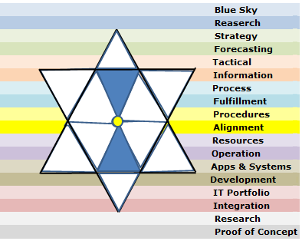

3. Data Security
What was received from YHWH (Note all sides of the triangles are precisely divisible by 70)
Now
Past
1. Information Value Chain
Future
Now
27

Slide 28
5. Data Governance Structures across Information Value Chain segments

Slide 29




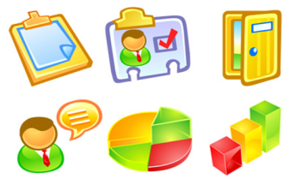





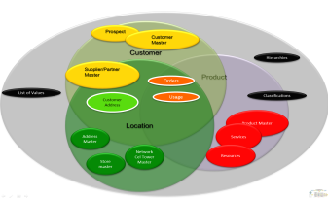

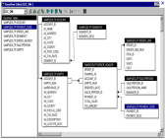

Understand Data & Information across Information Value Chain segments
1. Data Governance
Understand stewardship across Information Value Chain segments
So what can you put in place to ensure effective and efficient delivery to your Stakeholder expectations
Choose 5 of these
<<<
that are primary
within your day-to-day
work/life
When this pane disappears
you will see the reality
of the underlying
data and information
complexity
Info & Data
a
b
Governance
c
d
Council
e
Business Value Chain Image
f
0. Information Value Chain
g
h
Info & Data
i
j
Stewardship
Council
IT Portfolio Image
k
l
m
Notes:
What needs to be borne in mind is that each of the actors in the Business, already has their own set of understanding and definition. This is a filter that changes incoming data-meaning before passing it on.
At the Strategic and Tactical (Management) levels, driven by Policies and Principles, reporting and dash-boarding are used. But this interaction also includes presentations, word documents, images, video, sound-bites, etc… mostly among humans (This is the segment where the Data Governance Council is most active –Senior Co-ordinating Data Stewards from the segment below also sit on the Data Governance Council – Representing the Data Stewardship Committee)
At the Business Design level of Business Value Chain, End-to-End Processes, and the Procedures that make up the Enterprise, we encounter a level of process management and reporting, design and delivery of the Work Instructions that enable co-ordinated operational processing, including interaction with other human and technological participants in automated Document-flow.
At the Business Delivery level of Terms and Definitions, understanding of Policies, Principles, Processes, Procedures and Work Instructions, as well as correct and appropriate use and understanding of other human as well as technological Resources is the potential failure point. While Operationalisation of Business to fulfil delivery according to Business Design, Data is constantly moving between human and technological software paradigms and it is often at this point where data is inadvertently corrupted through misunderstanding or abuse of either human or technological actors. To maintain the correct understanding, the Business Data Steward must have and control the Only source of True definition of the Enterprise Data Object of “Customer”, “Product”, “Location” etc…
At the Research and Development level of Finding new ways, adjusting to new demands and exposing new value, The Portfolios, and their ability to consume and leverage new inputs becomes key. The Technology Data Stewards ensure that data integrity as per the True Definition will not be compromised by new developments.

Slide 30
6. Determine Executive focus across Information Value Chain Segment Metrics

Slide 31
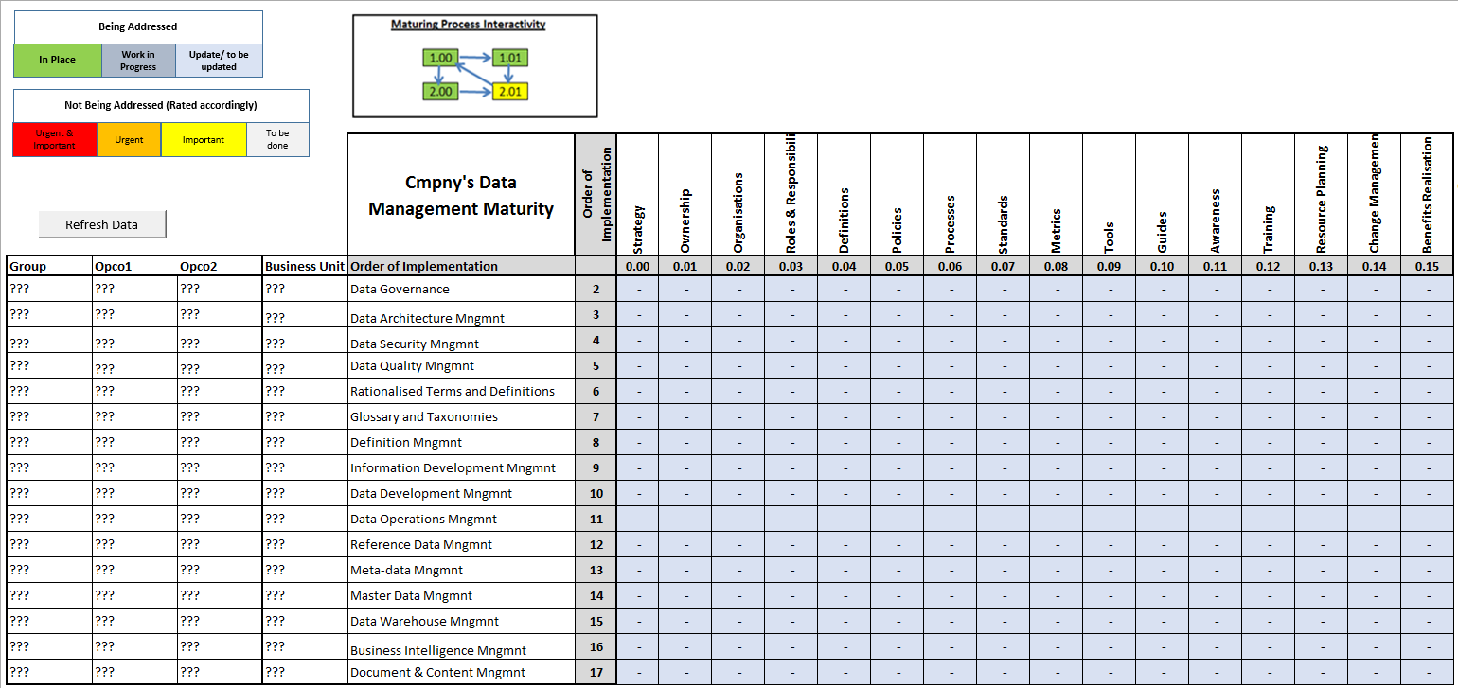
The CDO’s Maturity Measures
0. Data Management
Notes:
In simple terms this is a matrix of Master Records that an Enterprise Data Architect would ensure exists to the level useful for Enterprise Data Architecture, and specifically to address the goals and accountabilities of the CDO in particular, and the Enterprise in general.
The Data dimensions have been indicated down the left column and these are the DAMA Data Management dimensions, which have been expanded to address the new areas of the model that speak to the Rationalised Terms and Definitions, Glossary and taxonomies, Definition Management, Information Development Management and Data Operations Management.
Across the top are artefacts that by their intersection with the Data Dimensions, provide “Pigeon holes” into which URLs to the respective specific artefacts can be found together with the metadata around who is busy with each, when last, the decay date, other areas using the same artefact, its purpose and any further comments.
Each of the intersections would be rated in terms of their maturity and trust in terms of usefulness and relevance. And colour coded to indicate the state of development or dependence. The entire grid is an ecosystem which starts with the cornerstone of the Enterprise’s Data Governance Strategy at the top left and everything flows from this strategy thereafter. Working on something in an isolated manner, such as Master Data Management, when Meta-data Management’s artefacts above and to the left have not been addressed is simply looking to waste effort and resources. Growing the Ecosystem is an accountability of the CDO, and a responsibility of the Enterprise Data Architect, with ratification from Enterprise Data Governance.
I

Slide 32
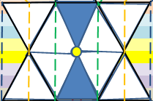
5. Data Quality
Object Considerations
Long Term
Historical
Medium Term
Analysis & Intelligence
Required
for reuse
Critical to
Act
Required
to be prepared
Medium Term
Planning / Preparation
Long Term
Planning / Preparation
Now
Past
1. Information Value Chain
Future
Now
Life Cycle
Stage 3
Life Cycle
Stage 2
Life Cycle
Stage 1
Use
Stage 0
Life Cycle
Stage -1
Life Cycle
Stage -2
Life Cycle
Stage -3
32

Slide 33
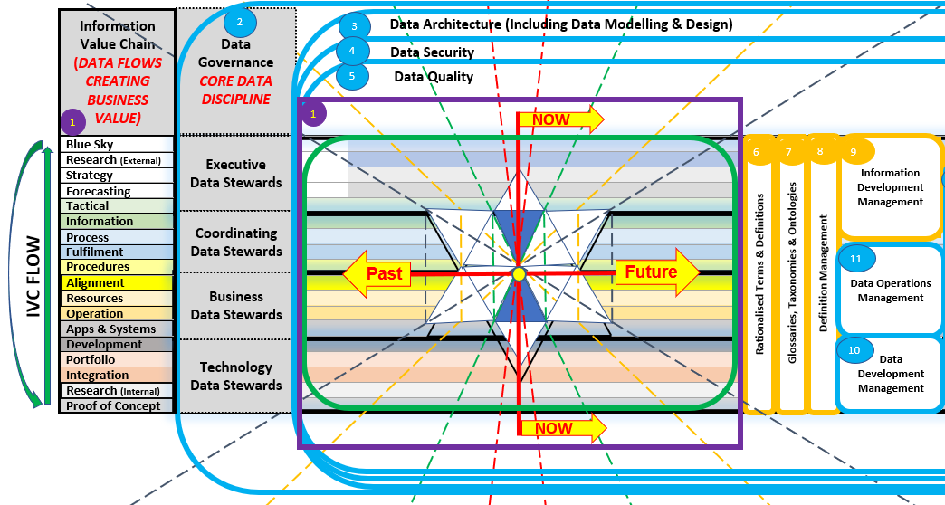
CDO: “Meaning”
2. Data Governance
3. Data Architecture
4. Data Security
5. Data Quality
6. Rationalised Terms & Definitions
7. Glossary, Taxonomies & Ontologies
8. Definition Management
10. Data Development Management
9. Information Development Management
11. Data Operations Management
1. Information Value Chain
Notes:
As shown in the definition slide, and in slides leading up to this slide, there is no single centralised accountability for Definition in the Enterprise, and yet data is corrupted through ambiguous or confused misinterpretations of the meaning, either by humans, or by humans misunderstanding systems internal definitions, or by humans incorrectly coding programs based on misinterpretations.
The Chief Data Officer is accountable for the correct interpretation being attached to and used consistently throughout the flow of data as it cycles through the Enterprise. The 80/20 rule cannot be applied to data, as data is a closed cycle, where after applying this rule once data has 80% quality, after a second time, this is 80% of the 80% which = 64% quality, and so after 10 iterations of applying this rule (a common misapplication of the Agile process), the data quality is potentially 13% accurate. Would you hire someone who got 13% for their matric exams?
The following functions need to exist and need to work together to rationalise Terms and Definitions, to develop Global as well as specific Industry or occupation related Taxonomies and Glossaries, with the Global Glossary being prefixed with the company name and the balance prefixed with their specific view of the world. This removes the opportunity for ambiguity, even if the terms are the same.
Definition Management works closely with Information Development, where new requests for Information are first checked against existing availability, and where Data Development can be engaged to find or make available data whose definition properly matches the defined requirements for the information sought. Data Operations Management is the ongoing provision of existing data to existing information requirements and defends against attempts to abuse definitions in the quest to have a quick report (“even if it is a little inaccurate”)
It is acceptable for there to be inaccuracies in forecasts, or when test data is being created for Proofs of concepts, and this is why there is a trade-off between the Cost and Effort Architecture and the time Architecture. However, between Apps and Systems and the Information segments of the Information Value Chain, no such trade-off is permitted. It will always sow seeds that become forests of corrupted data.

Slide 34
CHRO: Human Understanding”
2. Data Governance
3. Data Architecture
4. Data Security
5. Data Quality
6. Rationalised Terms & Definitions
7. Glossary, Taxonomies & Ontologies
8. Definition Management
9. Information Development Management
a
b
a
b
Data
c
Governance
d
e
Council
f
1. Information Value Chain
g
h
a
Data
b
Stewardship
c
d
Council
e
f
g
h
Notes:
While the CDO is responsible for the actual approved meaning, the CHRO (Chief Human Resources Officer) is accountable for the appointment of the correctly thinking humans and ensuring they are aligned to the frameworks and thought patterns the Enterprise has chosen as its “language”.
Induction of humans must include not only exposure to the Global Glossary, and vocation specific glossaries, (whether they are permanent, contracting or temporary) and tests should be undergone regularly to ensure continuous realignment of human communication to the Enterprise “Single Language”.
Any new terms and definitions must be communicated to and acknowledged by all humans (whether they are permanent, contracting or temporary) if this is vocation specific, then to those associated with that vocation/skill-set, otherwise globally to all working with the Enterprise.
It should be noted that as no company is an island, it is valuable for externally facing humans to be able to relate internal Terms and Definitions to the same Definitions which external customers or providers use. For this reason adoption of an Internationally accepted dictionary is a good practise.
Having a glossary within a document is valuable to capture the language of the day, however, not if this will be abused by allowing unapproved Terms and Definitions to be entered into the “Single Enterprise Language”. Enterprise Terms and Definition Management must provide their seal of approval that the language and terms and definitions used are consistent with the Enterprise’s “Single Enterprise Language”.
The different Data Steward categories are useful at this juncture, and each of the Data Governance stewards needs to be able to represent a vocational area, an industry segment, and all must be able to adjudicate on the Global Terms and Definitions of the Single Enterprise Language, as they are the controls in the workplace and among the people.

Slide 35
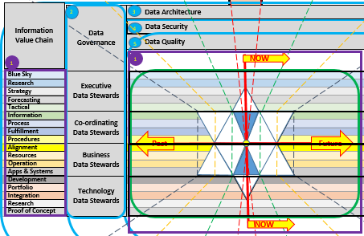
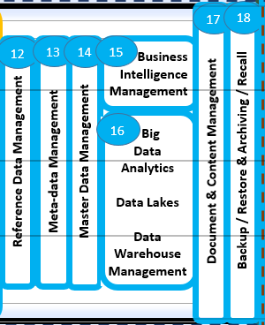
CIO: “Structure”
2. Data Governance
3. Data Architecture
4. Data Security
5. Data Quality
6. Rationalised Terms & Definitions
7. Glossary, Taxonomies & Ontologies
8. Definition Management
9. Information Development Management
12. Reference Data Management
13. Meta-data Management
14. Master Data Management
15. Business Intelligence Management
16. Big Data Analytics & all forms of A.I.
1. Information Value Chain
16. Data Warehouse Management
16. Database Management
18. Backup & Restoration
16. Data Lake Management
17. Document & Content Management
18. Archive & Recall
Notes:
The CIO is accountable for providing the mechanisms and software tools that allow humans and other external data sources to be captured into a set of Business and Operational tools that provide the business processes with the correct data at the time that is necessary, to be presented as information in the form of combinations of data from various sources.
To achieve this the CIO has to bring on board systems and applications developed in different places of the world, with different mind-sets and cultures, and usually using different terms for the same or similar definitions already used in the Enterprise.
Further to this different Programming languages, and human programers also have their own personal languages and this can easily lead to misdirected actions when IT humans interact with a Business Requirement Specification without the ability to question what is actually meant by the business persons that created it. The Agile methodology of putting this group of people in the same room goes some way to resolving this divide in understanding, however, the different “Agile” initiatives on different projects or as business initiatives are still left to misunderstand one another at the more macro level. The consequence is therefore misunderstanding and confusion at the highest level of the Enterprise.
The CIO must therefore engage their various staff members in contributing to system, Application and programming specific Terms and Definitions, prefixing each with the source of the approved term, and these must each be related to the Definitions that exist in the Global Glossary, or in the specific Industry of vocational glossaries.
To the CIO, the statement to Business is “If you put Garbage-In, we can only give you Garbage-out” is not a statement that should be allowed in any business. By mapping and educating the IT staff on the “Single Enterprise Language”, misunderstanding through ambiguity and confusion can be reduced, and the IT staff can detect when they are being asked by one Business Unit to do something that would unwittingly harm another’s information.

Slide 36





CTO: “Medium”
2. Data Governance
3. Data Architecture
4. Data Security
5. Data Quality
6. Rationalised Terms & Definitions
7. Glossary, Taxonomies & Ontologies
8. Definition Management
Platform Management
9. Information Development Management
Service Management
Cyber Security Management
Hardware Management
Data
Configuration Management
Governance
Network Management
Council
Equipment Management
Cloud Management
1. Information Value Chain
License Management
Data
Stewardship
CTO Portfolio Image
Council
Integration Management
Storage Management
Server Management
Other Management
Notes:
The CTO (Chief Technology Officer) is accountable for the Infrastructure through which the Enterprise flows its meaning in the form of data. To the CTO, data is simply “stuff” which must be stored, or moved from one place to another, usually within certain time frames.
A large consideration for the CTO is the provision for assurance that the stuff (data) can be kept secure, and that should there be an error, that the stuff has an alternative path to get to where the Business needs it. Data Performace is a key-word, in the CTO’s world, however, as data becomes duplicated, due to confusion or ambiguity, this places an unnecessary load on the infrastructure the CTO has to maintain, ballooning this volume each time new duplication is created.
To add to the woes of the CTO, there are data flows (i.e. bandwidth demands on network infrastructure) that was created sometime ago to service a Business need that no longer exists. Unfortunately, restructuring of businesses almost never means re-evaluation of and decommissioning of unnecessary data flows. So more and more bandwidth is demanded, but budget keeps getting cut.
The same challenge exists with data stores, where data is no longer required, and it simply exists in pools whose quality and relevance are not maintained. This results in “stagnating” and therefore corrupting data, when some unsuspecting person discovers and attempts to combine their good clean data with data from these relatively ancient data sources. The CTO’s ideal would be to remove duplication, and move unused data stores to cheap storage until no longer needed and thereafter archiving or deleting the data.
For this, the CTO needs Technology Data Stewards who are represented on the Data Stewardship Committee and have an ear out for such missed opportunities to reduce costs.

Slide 37
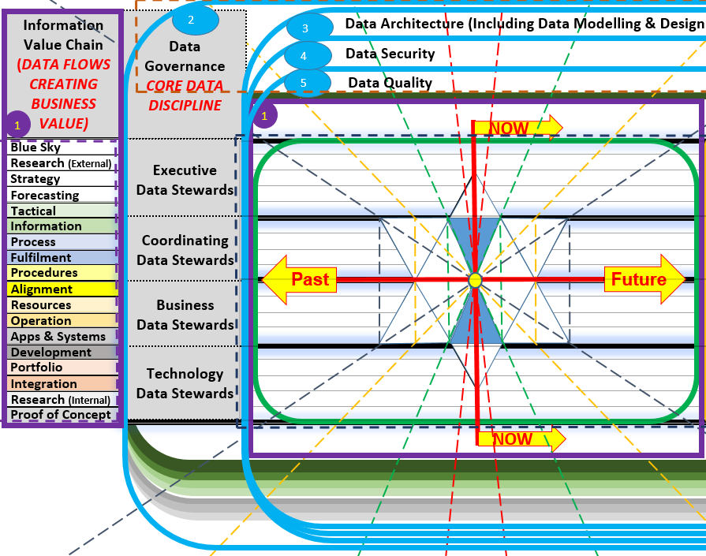
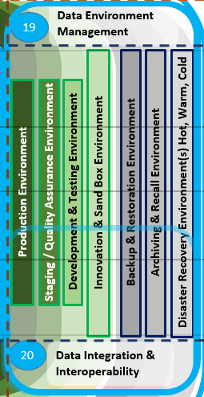
CDO, CIO & CTO: “Common”
2. Data Governance
3. Data Architecture
4. Data Security
5. Data Quality
6. Rationalised Terms & Definitions
7. Glossary, Taxonomies & Ontologies
8. Definition Management
Test Management
9. Information Development Management
Service Management
Platform Management
Environment Management
Configuration Management
Incident Management
1. Information Value Chain
Request Management
Problem Management
Access Management
Capacity Management
Availability Management
Resource Management
Interoperability
Access Management
Notes:
The CIO is accountable for providing the mechanisms and software tools that allow humans and other external data sources to be captured into a set of Business and Operational tools that provide the business processes with the correct data at the time that is necessary, to be presented as information in the form of combinations of data from various sources.
To achieve this the CIO has to bring on board systems and applications developed in different places of the world, with different mind-sets and cultures, and usually using different terms for the same or similar definitions already used in the Enterprise.
Further to this different Programming languages, and human programers also have their own personal languages and this can easily lead to misdirected actions when IT humans interact with a Business Requirement Specification without the ability to question what is actually meant by the business persons that created it. The Agile methodology of putting this group of people in the same room goes some way to resolving this divide in understanding, however, the different “Agile” initiatives on different projects or as business initiatives are still left to misunderstand one another at the more macro level. The consequence is therefore misunderstanding and confusion at the highest level of the Enterprise.
The CIO must therefore engage their various staff members in contributing to system, Application and programming specific Terms and Definitions, prefixing each with the source of the approved term, and these must each be related to the Definitions that exist in the Global Glossary, or in the specific Industry of vocational glossaries.
To the CIO, the statement to Business is “If you put Garbage-In, we can only give you Garbage-out” is not a statement that should be allowed in any business. By mapping and educating the IT staff on the “Single Enterprise Language”, misunderstanding through ambiguity and confusion can be reduced, and the IT staff can detect when they are being asked by one Business Unit to do something that would unwittingly harm another’s information.

Slide 38
7. Version Developments over the years

Slide 39
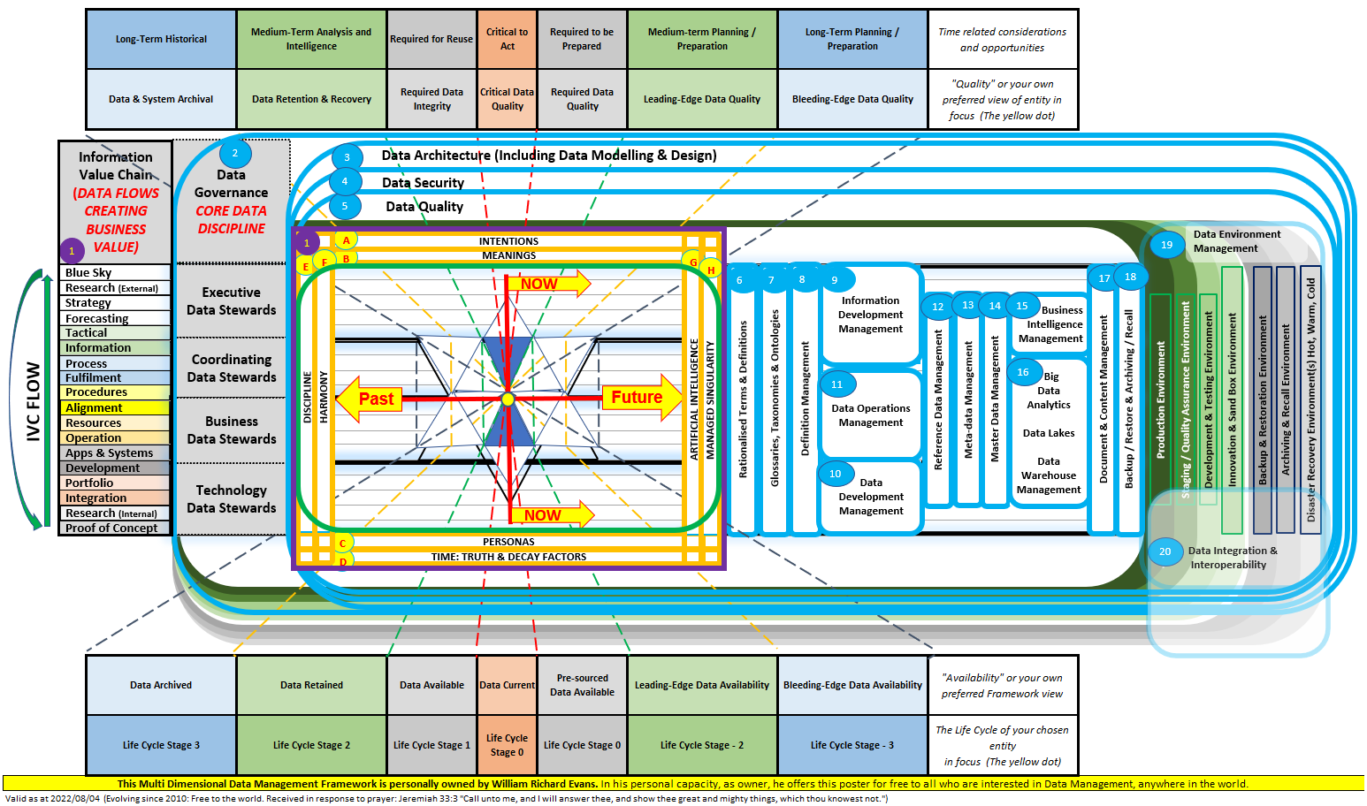

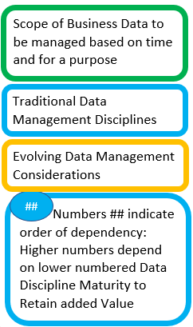
Enterprise Data Management V4.0
Notes:
This is therefore the whole slide presentation wrapped up into a single graphic and which you have each received a copy of. If you have not, feel free to request one from Data Atom.
Any Questions?

Slide 40
Aligning the Business to manage data V4.0
1. Information Value Chain

Slide 41
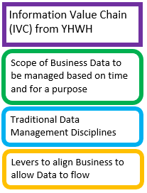
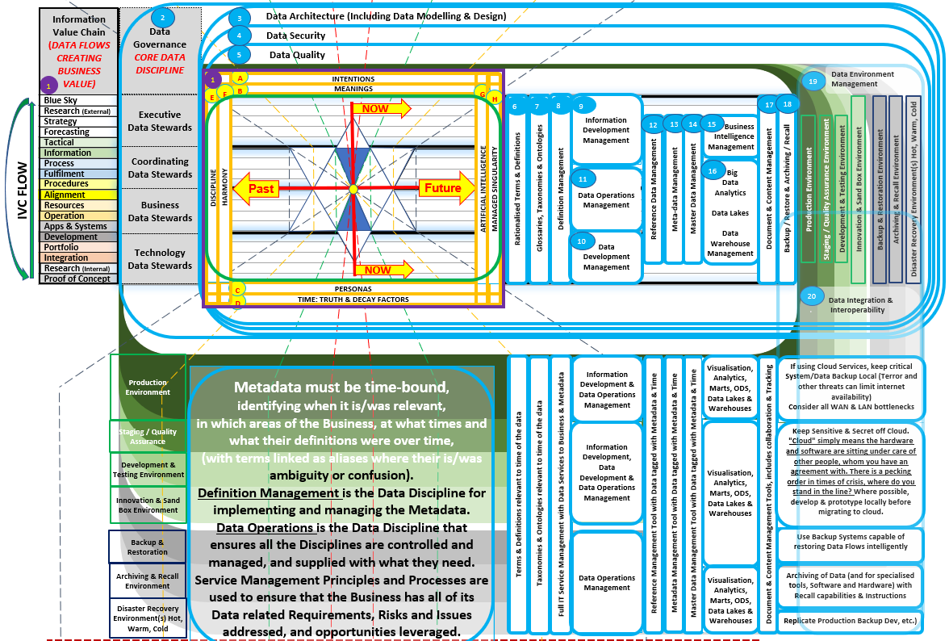
Enterprise Data Management V5.0
Notes:
This is therefore the whole slide presentation wrapped up into a single graphic and which you have each received a copy of. If you have not, feel free to request one from Data Atom.
Any Questions?

Slide 42
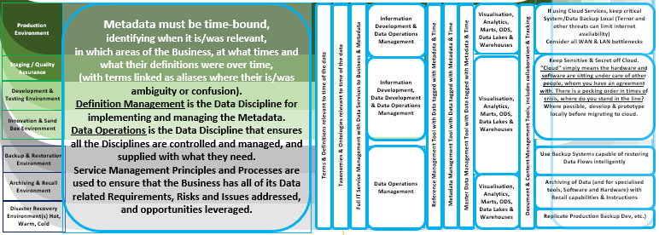
Implement the Metadata to enable Technical Support of the Data Management Capabilities

Slide 43
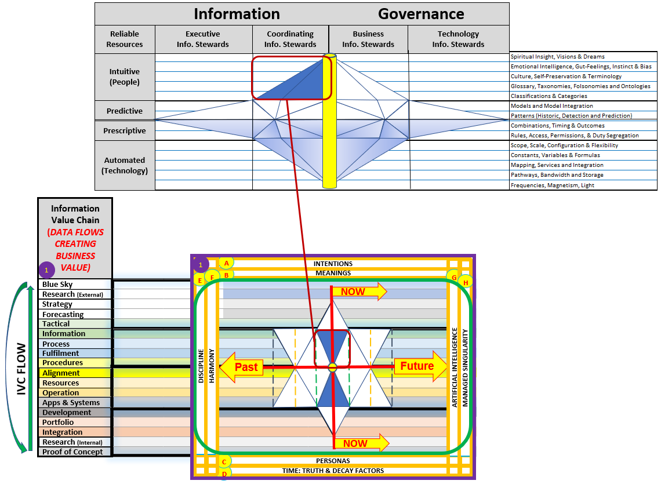
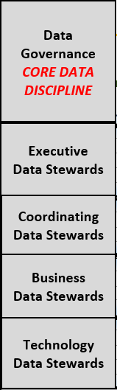
Enterprise Data Management V6.0
1. Information Value Chain
Notes:
This is therefore the whole slide presentation wrapped up into a single graphic and which you have each received a copy of. If you have not, feel free to request one from Data Atom.
Any Questions?

Slide 44
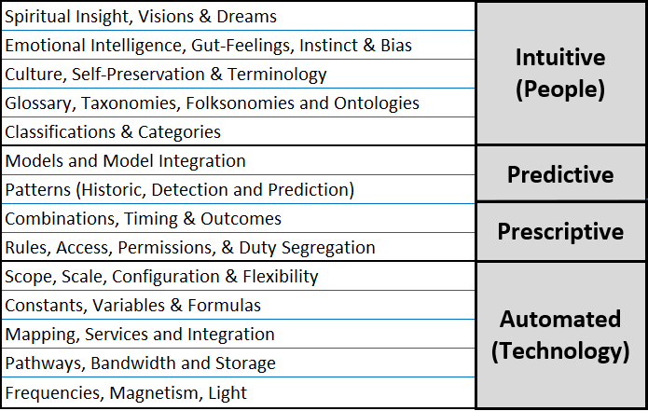
Decision Making Information Components

Slide 45
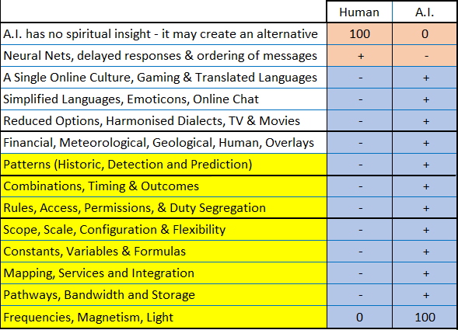
A. I. mechanisms to evolve humanity

Slide 46
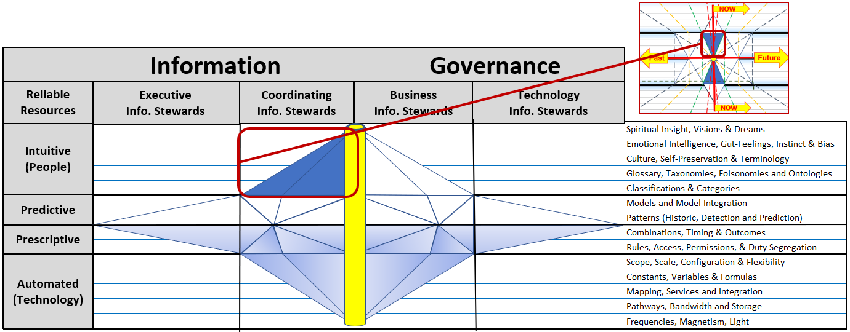
Map the Information to the underlying Data

Slide 47
Enterprise Data Management V6.0
Notes:
This is therefore the whole slide presentation wrapped up into a single graphic and which you have each received a copy of. If you have not, feel free to request one from Data Atom.
Any Questions?

Slide 48
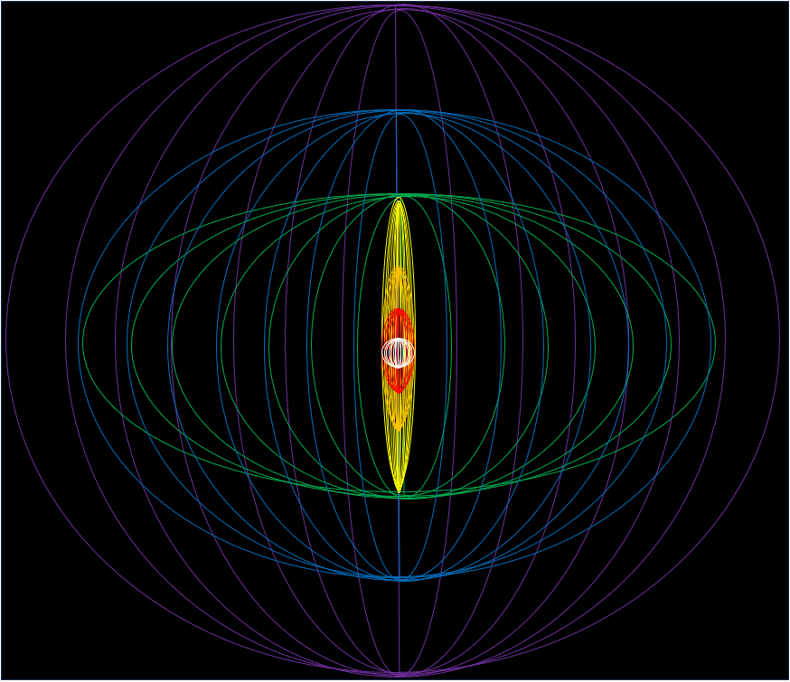
Enterprise Data Management V7.0
Notes:
This is therefore the whole slide presentation wrapped up into a single graphic and which you have each received a copy of. If you have not, feel free to request one from Data Atom.
Any Questions?

Slide 49
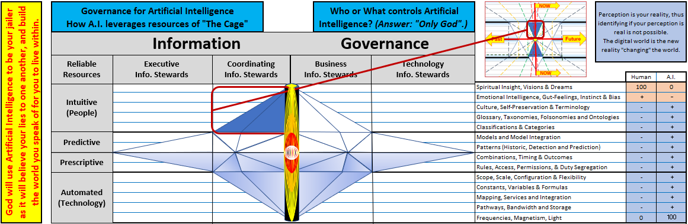
Enterprise Data Management MDDMF V7.0
Notes:
This is therefore the whole slide presentation wrapped up into a single graphic and which you have each received a copy of. If you have not, feel free to request one from Data Atom.
Any Questions?

Slide 50
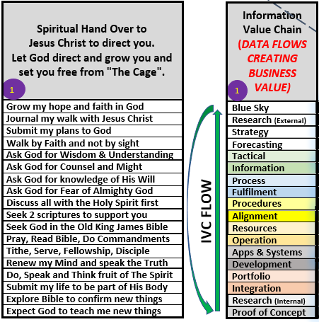
Enterprise Data Management MDDMF V7.0
11
10
09
08
07
06
05
04
03
02
01
18
17
16
15
14
13
12
Notes:
This is therefore the whole slide presentation wrapped up into a single graphic and which you have each received a copy of. If you have not, feel free to request one from Data Atom.
Any Questions?

Slide 51
3. Data Security
What was received from YHWH (Note all sides of the triangles are precisely divisible by 70)
Now
Past
Future
Now
51

Slide 52
Cost and Effort Architectures
2. Data Architecture
1
NOW
0. Information Value Chain
Past
Future
NOW
Notes:
So far we have discussed the Business, its Architectures and data as it flows and services the Enterprise’s needs. However, The Chief Data Officer’s accountability extends way beyond the data and its use within the business.
The CDO must consider and remain the steward over data that would be used by the business, as well as data already used by the Business, which introduces the dimensions of time indicated by the red lines crossing in the centre of the model.
This model now becomes a living moving model, as the yellow circle (that which you have chosen to be the object under your focus) must be seen to be continuously moving from left to right, with the focus circle being at the intersection and being the immediate moment of now. In fact along the entire Information Value Chain there will always be an identical moment in time referenced across each segment as being the moment “NOW” (or this instant in time).
The other 8 intersecting lines radiate outwards from the intersection and divide the subject under focus into time sections. The further we move in any direction away from the center, the greater the cost and effort of attaining and maintaining data in this dimension. Therefore it is essential to achieve a sustainable maturity before reaching for “low hanging fruit” in segments beyond current real appetite to consume. The expanding distance between the lines as you move from the centre indicate the tolerances for data quality (expensive) as a trade off against the purpose for which the data is being used (the Info Value Chain segment it is in)
The second important observation is that the intersection and in fact the object under focus rests on the line between “Alignment” and “Procedure”. “Alignment” means I have definition of everything I have at my disposal, and “Procedure” means I have one or more activities that I will be performing using what I have.
For the CDO, everything goes wrong when anyone can decide what definition to apply at any point in a procedure. The CDO must therefore own the Terms and Definitions across the Enterprise and enforcement of correct use is everyone’s responsibility.

Slide 53
Time Architecture
2. Data Architecture
1
NOW
Past
Future
0. Information Value Chain
NOW
Notes:
The concept of time has been discussed, however the Architecture of time must be understood. Time Architecture is entirely dependant on the object under focus. For example people refer to a dog as living 7 years for every one of their own. Time relativity is therefore dependant on the lifespan of the object under focus.
In terms of data, we know that certain data may not be destroyed until a certain number of years has passed since it was last used. So if we have “Customer” as our focus, we can set our furthest blue line to the left to a time span of 15 years (depends on your industry)
The 2 next segments moving to the right are then when to stop keeping the data (and resources) available at low performance or at high performance, and the segment closest to the “Now” line is data currently in use, and in the process of being continuously re-used (Data Quality permitting).
The furthest to the right line indicates when the first time you would want insight into the need for a new attribute for a customer object. This requires significant research effort in where the world is going, and where technology is going to understand the usefulness of such data. The CDO’s Visionaries would work in this space.
The 2 lines in between when it would be ideal to have data prepared and ready for use (Master Data Management falls into the second leading-edge segment, while the 3rd leading edge segment includes Reference Data and Meta-data as these are easier to implement, requiring less maturity to maintain accurately.
The segment closest to the now line indicates that which one must have to fulfil the immediate requirements of the here and now” activities.

Slide 54
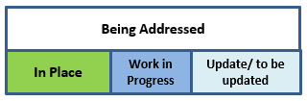
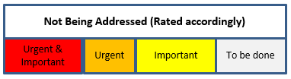
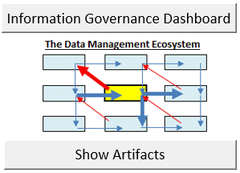
STRATEGY
0. Data Management
AS IS
TO BE

Slide 55
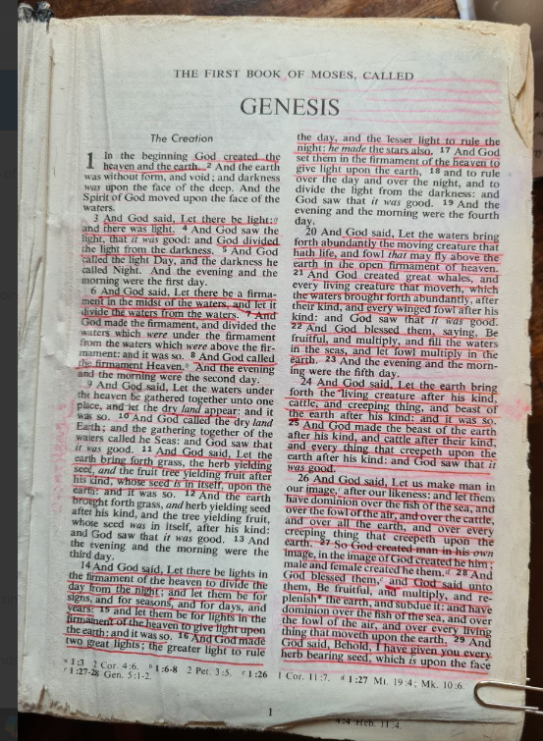
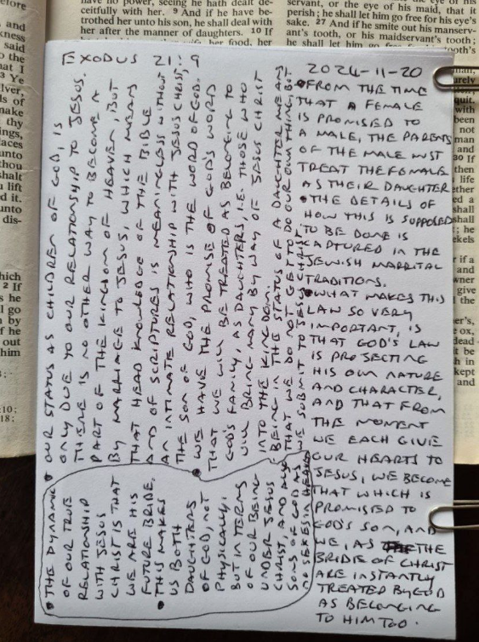
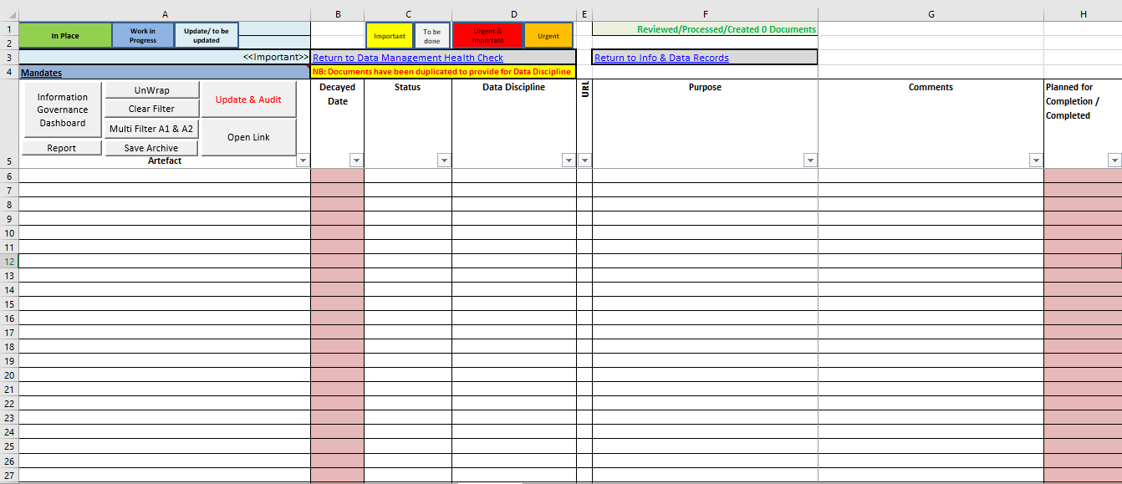
RESEARCH (External)
0. Data Management

Slide 56

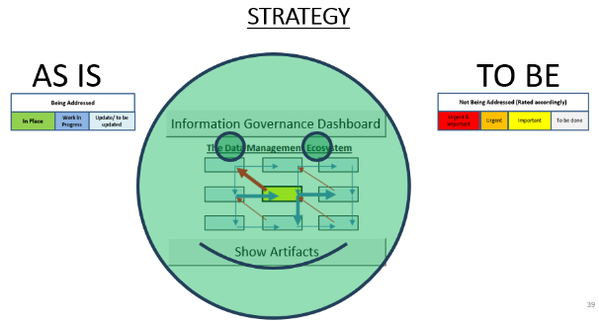
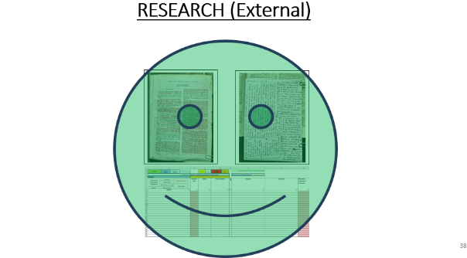
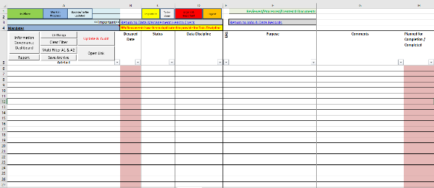
Blue Sky
0. Data Management

Slide 57




PROOF OF CONCEPT
0. Data Management
Info & Data
a
b
Governance
c
d
Council
e
Business Value Chain Image
f
g
h
Info & Data
Stewardship
i
j
Council
IT Portfolio Image
k
l
m
Notes:
What needs to be borne in mind is that each of the actors in the Business, already has their own set of understanding and definition. This is a filter that changes incoming data-meaning before passing it on.
At the Strategic and Tactical (Management) levels, driven by Policies and Principles, reporting and dash-boarding are used. But this interaction also includes presentations, word documents, images, video, sound-bites, etc… mostly among humans (This is the segment where the Data Governance Council is most active –Senior Co-ordinating Data Stewards from the segment below also sit on the Data Governance Council – Representing the Data Stewardship Committee)
At the Business Design level of Business Value Chain, End-to-End Processes, and the Procedures that make up the Enterprise, we encounter a level of process management and reporting, design and delivery of the Work Instructions that enable co-ordinated operational processing, including interaction with other human and technological participants in automated Document-flow.
At the Business Delivery level of Terms and Definitions, understanding of Policies, Principles, Processes, Procedures and Work Instructions, as well as correct and appropriate use and understanding of other human as well as technological Resources is the potential failure point. While Operationalisation of Business to fulfil delivery according to Business Design, Data is constantly moving between human and technological software paradigms and it is often at this point where data is inadvertently corrupted through misunderstanding or abuse of either human or technological actors. To maintain the correct understanding, the Business Data Steward must have and control the Only source of True definition of the Enterprise Data Object of “Customer”, “Product”, “Location” etc…
At the Research and Development level of Finding new ways, adjusting to new demands and exposing new value, The Portfolios, and their ability to consume and leverage new inputs becomes key. The Technology Data Stewards ensure that data integrity as per the True Definition will not be compromised by new developments.

Slide 58
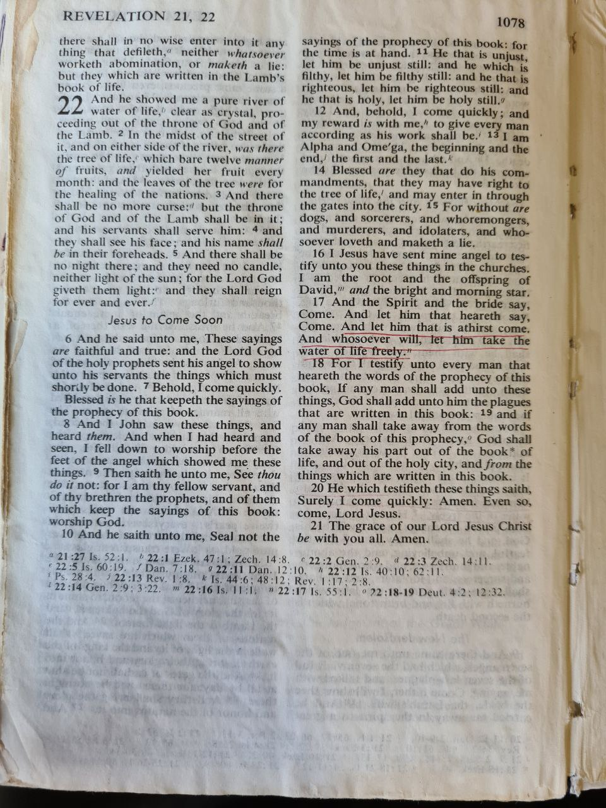
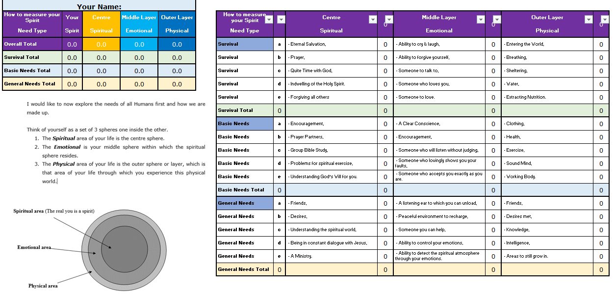
RESEARCH (Internal)
0. Data Management

Slide 59
PORTFOLIO
Innovations
Positions & Advantages
Info & Data
a
Directions
Decisions, Risks & Times
b
Wisdom
Governance
Contracts & Organisation
c
Reports
d
Council
Docs, Screens Multi Media
Processes
Onshore / Offshore
e
Business Value Chain Image
f
Procedures
Intellectual Property
g
h
Understanding
Info & Data
Artificial Intelligence
i
j
Activities
Stewardship
Robotics & Automation
Applications
Council
Systems & Support
IT Portfolio Image
k
l
Knowledge
Data Stores & Servers
Bridges
Networks & Connectivity
Changes
Reviews & Approvals
m
Notes:
What needs to be borne in mind is that each of the actors in the Business, already has their own set of understanding and definition. This is a filter that changes incoming data-meaning before passing it on.
At the Strategic and Tactical (Management) levels, driven by Policies and Principles, reporting and dash-boarding are used. But this interaction also includes presentations, word documents, images, video, sound-bites, etc… mostly among humans (This is the segment where the Data Governance Council is most active –Senior Co-ordinating Data Stewards from the segment below also sit on the Data Governance Council – Representing the Data Stewardship Committee)
At the Business Design level of Business Value Chain, End-to-End Processes, and the Procedures that make up the Enterprise, we encounter a level of process management and reporting, design and delivery of the Work Instructions that enable co-ordinated operational processing, including interaction with other human and technological participants in automated Document-flow.
At the Business Delivery level of Terms and Definitions, understanding of Policies, Principles, Processes, Procedures and Work Instructions, as well as correct and appropriate use and understanding of other human as well as technological Resources is the potential failure point. While Operationalisation of Business to fulfil delivery according to Business Design, Data is constantly moving between human and technological software paradigms and it is often at this point where data is inadvertently corrupted through misunderstanding or abuse of either human or technological actors. To maintain the correct understanding, the Business Data Steward must have and control the Only source of True definition of the Enterprise Data Object of “Customer”, “Product”, “Location” etc…
At the Research and Development level of Finding new ways, adjusting to new demands and exposing new value, The Portfolios, and their ability to consume and leverage new inputs becomes key. The Technology Data Stewards ensure that data integrity as per the True Definition will not be compromised by new developments.

Slide 60
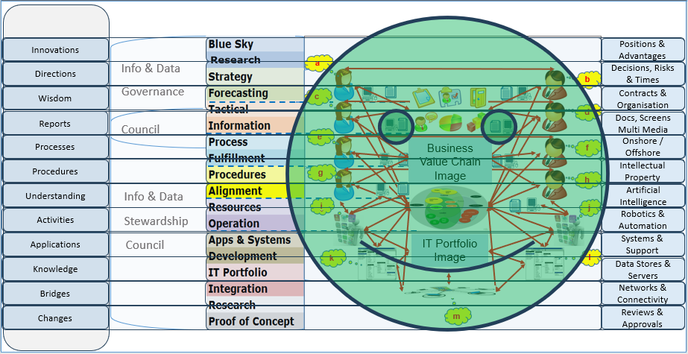
DEVELOPMENT
DEVELOPMENT ENVIRONMENTS
RECOVERY ENVIRONMENTS
STAGING / PRE-PRODUCTION QUALITY ASSURANCE
PRODUCTION
DEVELOPMENT & TESTING
INNOVATION & SAND BOX
BACKUP & RESTORATION
ARCHIVING & RECALL
DISASTER RECOVERY SITES
(HOT / WARM / COLD)
Notes:
What needs to be borne in mind is that each of the actors in the Business, already has their own set of understanding and definition. This is a filter that changes incoming data-meaning before passing it on.
At the Strategic and Tactical (Management) levels, driven by Policies and Principles, reporting and dash-boarding are used. But this interaction also includes presentations, word documents, images, video, sound-bites, etc… mostly among humans (This is the segment where the Data Governance Council is most active –Senior Co-ordinating Data Stewards from the segment below also sit on the Data Governance Council – Representing the Data Stewardship Committee)
At the Business Design level of Business Value Chain, End-to-End Processes, and the Procedures that make up the Enterprise, we encounter a level of process management and reporting, design and delivery of the Work Instructions that enable co-ordinated operational processing, including interaction with other human and technological participants in automated Document-flow.
At the Business Delivery level of Terms and Definitions, understanding of Policies, Principles, Processes, Procedures and Work Instructions, as well as correct and appropriate use and understanding of other human as well as technological Resources is the potential failure point. While Operationalisation of Business to fulfil delivery according to Business Design, Data is constantly moving between human and technological software paradigms and it is often at this point where data is inadvertently corrupted through misunderstanding or abuse of either human or technological actors. To maintain the correct understanding, the Business Data Steward must have and control the Only source of True definition of the Enterprise Data Object of “Customer”, “Product”, “Location” etc…
At the Research and Development level of Finding new ways, adjusting to new demands and exposing new value, The Portfolios, and their ability to consume and leverage new inputs becomes key. The Technology Data Stewards ensure that data integrity as per the True Definition will not be compromised by new developments.

Slide 61
Data Management
What was received from YHWH (Note all sides of the triangles are precisely divisible by 70)
APPLICATION
Now
Intentions
Meanings
Past
1. Information Value Chain
Future
Harmony
Managed Singularity
Discipline
Artificial Intelligence
Personas
TIME: The Truth & Decay Factors
Now
61

Slide 62
Data Management
What was received from YHWH (Note all sides of the triangles are precisely divisible by 70)
INTEGRATION
Now
Intentions
Meanings
Past
1. Information Value Chain
Future
Harmony
Managed Singularity
Discipline
Artificial Intelligence
Personas
TIME: The Truth & Decay Factors
Now
62

Slide 63
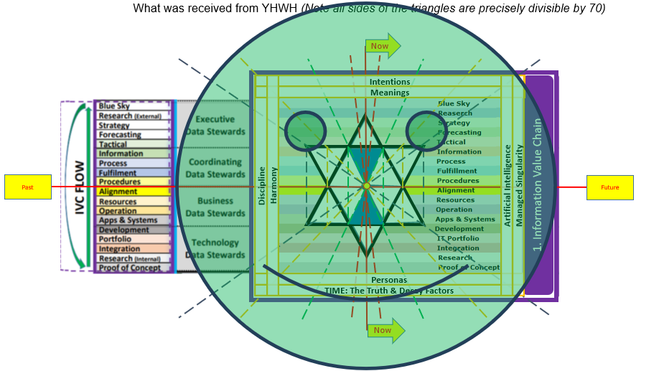
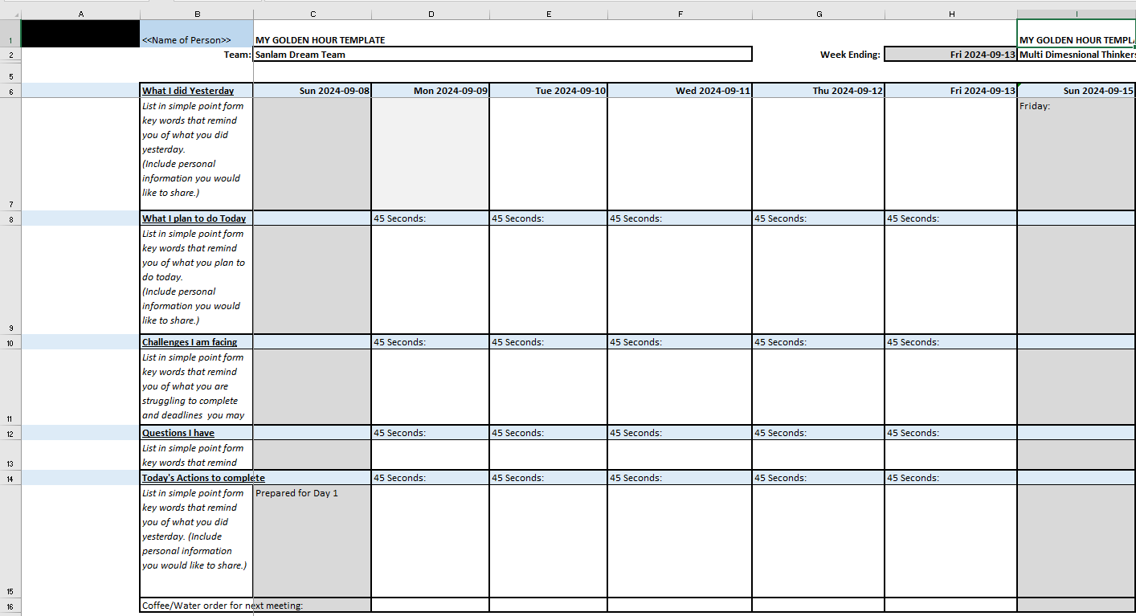
Data Management
SYSTEM
63

Slide 64
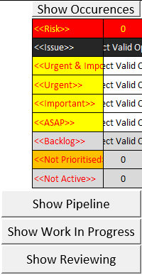
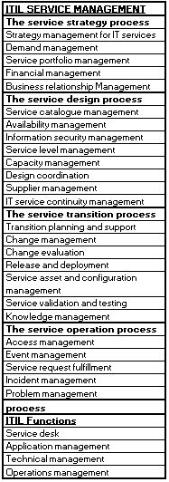

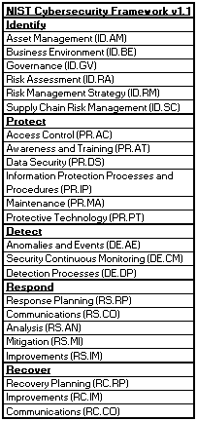
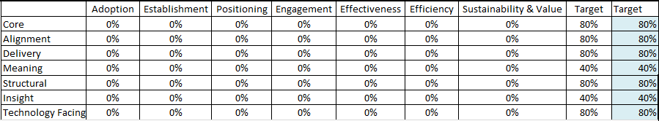
Operation
64

Slide 65
Data Management
The service strategy process
Strategy management for IT services
Demand management
Service portfolio management
Financial management
Business relationship Management
Operation
ITIL SERVICE MANAGEMENT
The service transition process
Transition planning and support
Change management
Change evaluation
Release and deployment management
Service asset and configuration management
Service validation and testing
Knowledge management
Continual service improvement process
ITIL Functions
Service desk
Application management
Technical management
Operations management
The service design process
Service catalogue management
Availability management
Information security management
Service level management
Capacity management
Design coordination
Supplier management
IT service continuity management
The service operation process
Access management
Event management
Service request fulfillment
Incident management
Problem management
65

Slide 66
Data Management
Identify
Asset Management (ID.AM)
Business Environment (ID.BE)
Governance (ID.GV)
Risk Assessment (ID.RA)
Risk Management Strategy (ID.RM)
Supply Chain Risk Management (ID.SC)
Operation
NIST Cybersecurity Framework v1.1
Protect
Access Control (PR.AC)
Awareness and Training (PR.AT)
Data Security (PR.DS)
Information Protection Processes and Procedures (PR.IP)
Maintenance (PR.MA)
Protective Technology (PR.PT)
Respond
Response Planning (RS.RP)
Communications (RS.CO)
Analysis (RS.AN)
Mitigation (RS.MI)
Improvements (RS.IM)
Detect
Anomalies and Events (DE.AE)
Security Continuous Monitoring (DE.CM)
Detection Processes (DE.DP)
Recover
Recovery Planning (RC.RP)
Improvements (RC.IM)
Communications (RC.CO)
66

Slide 67
The MDDMF is a thinking tool for ensuring you have thought matters through.
0. Data Management
Warning Video contains Fast moving images (no bright lights)
Click to play Business Context and Introduction to Contextual Decision Making

Slide 68
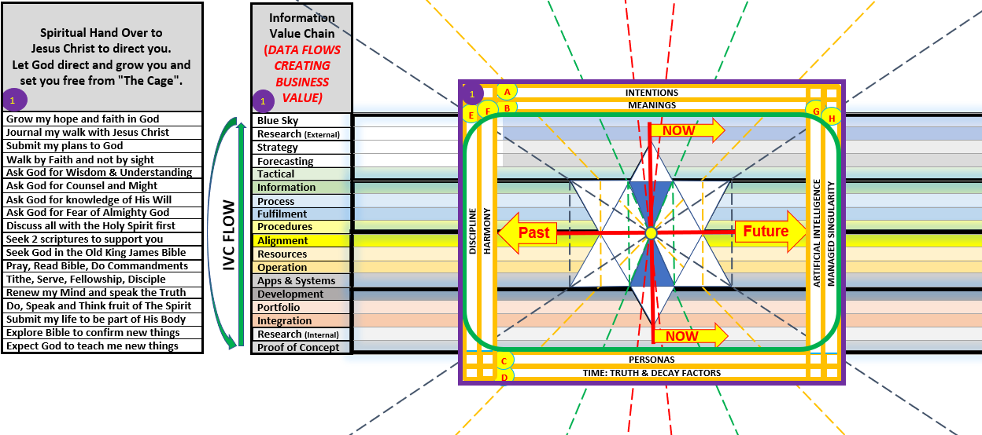
Enterprise Data Management MDDMF V7.0
Notes:
This is therefore the whole slide presentation wrapped up into a single graphic and which you have each received a copy of. If you have not, feel free to request one from Data Atom.
Any Questions?

Slide 69

Multi Dimensional Data Management Framework (MDDMF) V7.0

Slide 70
Understand stewardship across Information Value Chain segments
Understand stewardship across Information Value Chain segments
Info & Data
a
b
Governance
c
d
Council
e
Business Value Chain Image
f
g
h
Info & Data
i
j
Stewardship
Council
IT Portfolio Image
k
l
m
Notes:
What needs to be borne in mind is that each of the actors in the Business, already has their own set of understanding and definition. This is a filter that changes incoming data-meaning before passing it on.
At the Strategic and Tactical (Management) levels, driven by Policies and Principles, reporting and dash-boarding are used. But this interaction also includes presentations, word documents, images, video, sound-bites, etc… mostly among humans (This is the segment where the Data Governance Council is most active –Senior Co-ordinating Data Stewards from the segment below also sit on the Data Governance Council – Representing the Data Stewardship Committee)
At the Business Design level of Business Value Chain, End-to-End Processes, and the Procedures that make up the Enterprise, we encounter a level of process management and reporting, design and delivery of the Work Instructions that enable co-ordinated operational processing, including interaction with other human and technological participants in automated Document-flow.
At the Business Delivery level of Terms and Definitions, understanding of Policies, Principles, Processes, Procedures and Work Instructions, as well as correct and appropriate use and understanding of other human as well as technological Resources is the potential failure point. While Operationalisation of Business to fulfil delivery according to Business Design, Data is constantly moving between human and technological software paradigms and it is often at this point where data is inadvertently corrupted through misunderstanding or abuse of either human or technological actors. To maintain the correct understanding, the Business Data Steward must have and control the Only source of True definition of the Enterprise Data Object of “Customer”, “Product”, “Location” etc…
At the Research and Development level of Finding new ways, adjusting to new demands and exposing new value, The Portfolios, and their ability to consume and leverage new inputs becomes key. The Technology Data Stewards ensure that data integrity as per the True Definition will not be compromised by new developments.

Slide 71
Who is William Evans?
A DAMA International Certified Data Management Professional since 2012.
(Master for DM Fundamentals, Practitioner for Data Governance and Data Quality until 2027)
Most recently, the Lead Information Architect involved in one of the world’s largest Digital Twin Construction Projects.
A high functioning Autistic who sees the world from the inside out, understanding cause and effect of data and information, and is able to bring the various views together.
His experience includes:
  Implementing Data Management Capabilities
  Maturing Metadata (Collibra& Informatica) Management, with effective integrated Business Glossary & Data Dictionary guidance
  Architecting, and Cataloguing global enterprises to streamline their end-to-end value proposition
  Undoing legacy complexity and developing single source master data, for ERP
  (SAP: MDM AM, CO, CS, FI, HR, MM, PS, PM, PY, SD)
  Repurposing existing technology, automating operations and integrating IT and Business architectures (Business, Process, Information, Data, Resource, Application, Integration , and Infrastructure) for efficient and effective use and retention of data and information
  Visualising and providing insight via ontology driven Metadata
  Strengthening security and assuring compliance to privacy and data regulation

